Slide 1
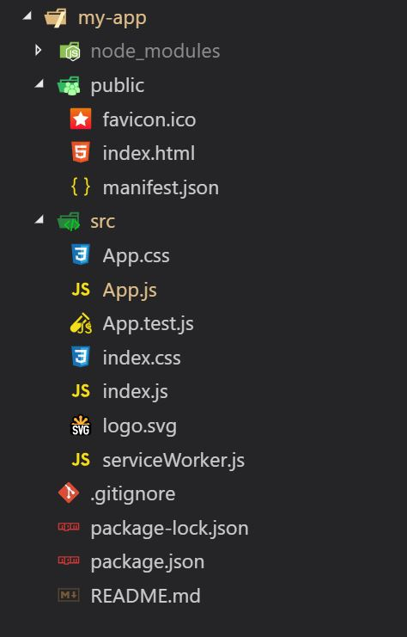
Directory Structure

Slide 2
Directory Structure
my-app – This is your Project Name
node_modules – It contains all packages and dependencies installed.
public -
favicon.ico – It’s a favicon for website
index.html – This file holds the HTML template of our app.
manifest.json - manifest.json provides metadata used when your web app is installed on a user's mobile device or desktop.
src
App.css – It’s a css file related to App.js but its global.
App.js – It’s Parent component of your react app
App.test.js – Its Test environment
index.css - It’s a css file related to index.js but its global
index.js – It’s the JavaScript entry Point.
logo.svg – React logo file
serviceWorker.js – It can help to access website offline.
.gitignore – It is used when you want to ignore git push.
package-lock.json – Its version control package json file
package,json – All dependencies mentioned in this file.
README.md – It readme file
For the project to build, these files must exist with exact filenames

Slide 3
public Folder
If you put a file into the public folder, it will not be processed by Webpack (Webpack does not read the public folder; it will only read the files inside the src folder). Instead it will be copied into the build folder untouched.
To reference assets in the public folder, you need to use a special variable called PUBLIC_URL.
Only files inside the public folder will be accessible by %PUBLIC_URL% prefix.
<link rel="shortcut icon" href="%PUBLIC_URL%/favicon.ico">
When you run npm run build, Create React App will substitute %PUBLIC_URL% with a correct absolute path so your project works even if you use client-side routing or host it at a non-root URL.

Slide 4
public Folder
You need a file with a specific name in the build output, such as manifest.webmanifest.
You have thousands of images and need to dynamically reference their paths.
You want to include a small script like pace.js outside of the bundled code.
Some library may be incompatible with Webpack and you have no other option but to include it as a <script> tag.

